Slide 1

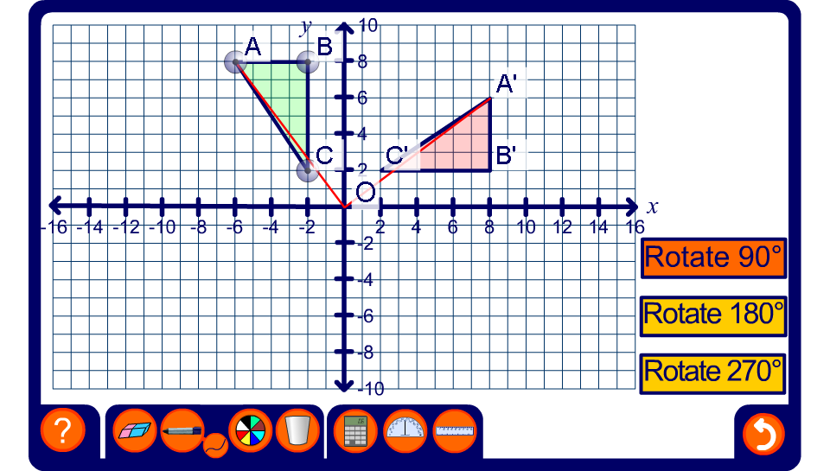


Rotations on a coordinate grid
Notes:
Remind pupils that, unless stated otherwise, positive rotations are always taken as anticlockwise. Demonstrate each rotation, dragging the vertices to change the shape and dragging on the shape to change its position.
Investigate the relationship between the coordinates of the object and its image for 90°, 180° and 270° rotations. This can be done by revealing the coordinate of A and A’ say, moving the shape (or the point) around the grid and observing the change in the coordinates.
Pupils should notice that when a shape is rotated through 90º about the origin, the x-coordinate of each image point is the same as the y-coordinate of the original point × –1 and the y-coordinate of the image point is the same as the x-coordinate of the original point.
When a shape is rotated through 180º about the origin, the x-coordinate of each image point is the same as the x-coordinate of the original point × –1 and the y-coordinate of the image point is the same as the y-coordinate of the original point × –1. In other words the coordinates are the same, but the signs are different.
When a shape is rotated through 270º about the origin, the x-coordinate of each image point is the same as the y-coordinate of the original point and the y-coordinate of the image point is the same as the x-coordinate of the original point × –1.

